Slide 1
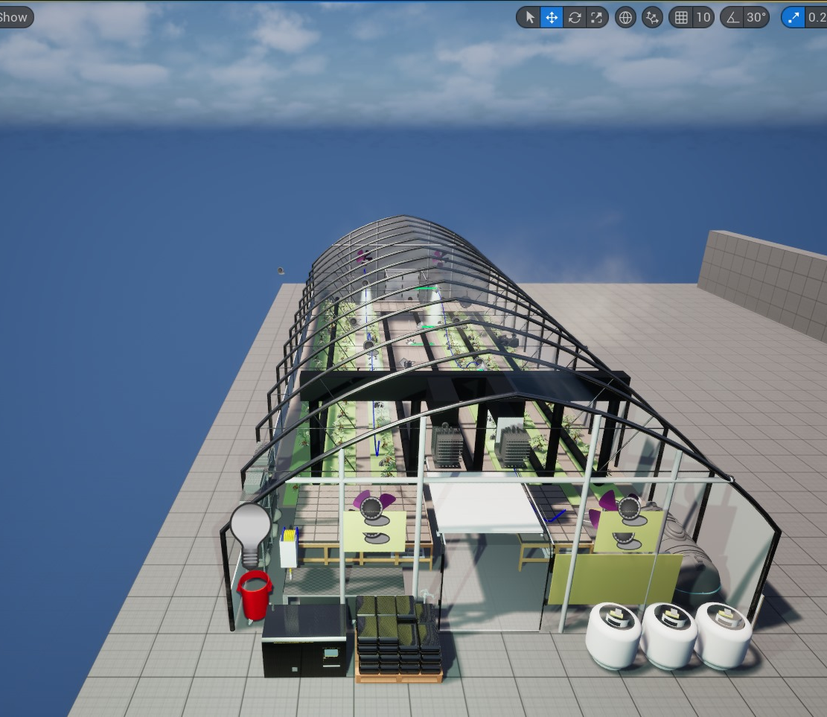
Smart Campus – Construction of Virtual Campus

Slide 2

Project Goal and Purpose
Create a realistic 3D greenhouse simulation
1
Monitor and adjust climate conditions
2
Focus on tomato plant growth optimization
3
Enable users to experiment with environmental settings
4
Notes:
The objective of our project was to create a fully functional digital twin of a real greenhouse.
Our aim was not only to simulate the environment, but also to dynamically respond to changes in climate conditions such as temperature, humidity, and CO₂ — all while visually representing these changes in real time.
We focused on tomato plants because they are highly sensitive to environmental shifts, making them an excellent case for testing our simulation logic.
The idea is that users — whether they’re researchers, students, or growers — can test out different climate conditions and see how they affect plant health and growth.”

Slide 3
Why Sketchup and Unreal Engine
Why Sketchup?
Easy-to-use interface for architectural modeling
Ideal for quick layout of structural designs
Compatible export formats for game engines (e.g., .FBX, .DAE)
Lightweight for creating scalable components
Used for initial structure blocking and layout
Why Unreal Engine?
Real-time rendering and photorealistic visuals
Blueprint system allows easy logic creation without code
Supports complex animation, lighting, and interactivity
Built-in physics and simulation tools
Great for creating immersive environments and user experiences

Slide 4

Greenhouse Components
Gas heater: Controls internal temperature
Camera: Takes pictures and videos of the greenhouse
Water tanks: Manage irrigation
Curtains & vents: Regulate light and humidity
Fans: Circulate air
Lamps: Provide artificial lighting
Notes:
To simulate a real-world greenhouse, we first identified the key components used in actual greenhouse environments.
Then, in our virtual setup, we recreated: • A power-vented gas-fired heater that adjusts the internal air temperature. • Water tanks that connect to irrigation pipes — essential for simulating moisture control. • Curtains and vents, which are attached to motors and open or close based on light or temperature levels. • Fans for air circulation. • And LED grow lamps to simulate sunlight during dark cycles.
All of these were placed into the virtual greenhouse structure and made functional using a combination of modeling and animation systems.

Slide 5
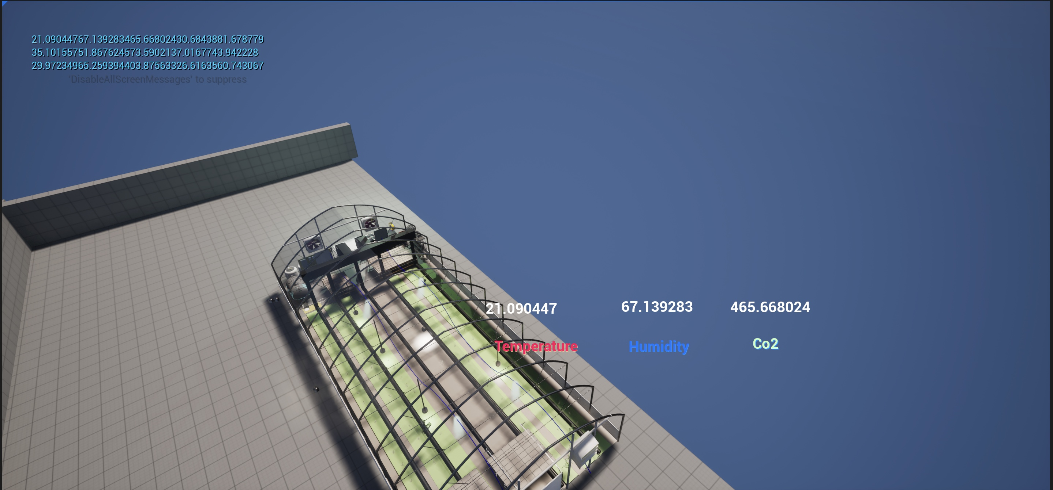
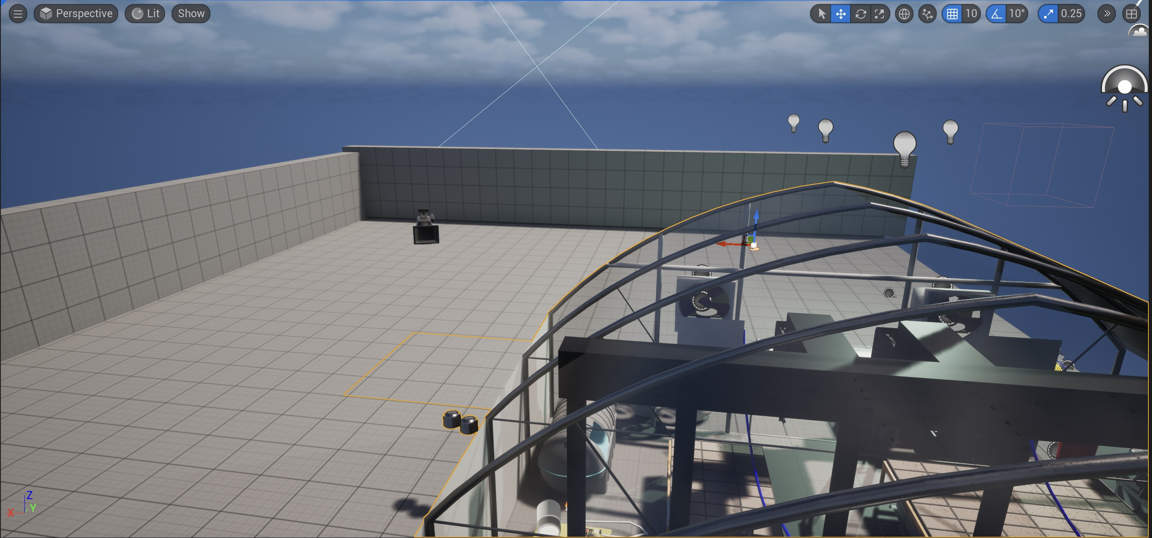

Components – Temperature, CO2, Camera, Fans

Slide 6
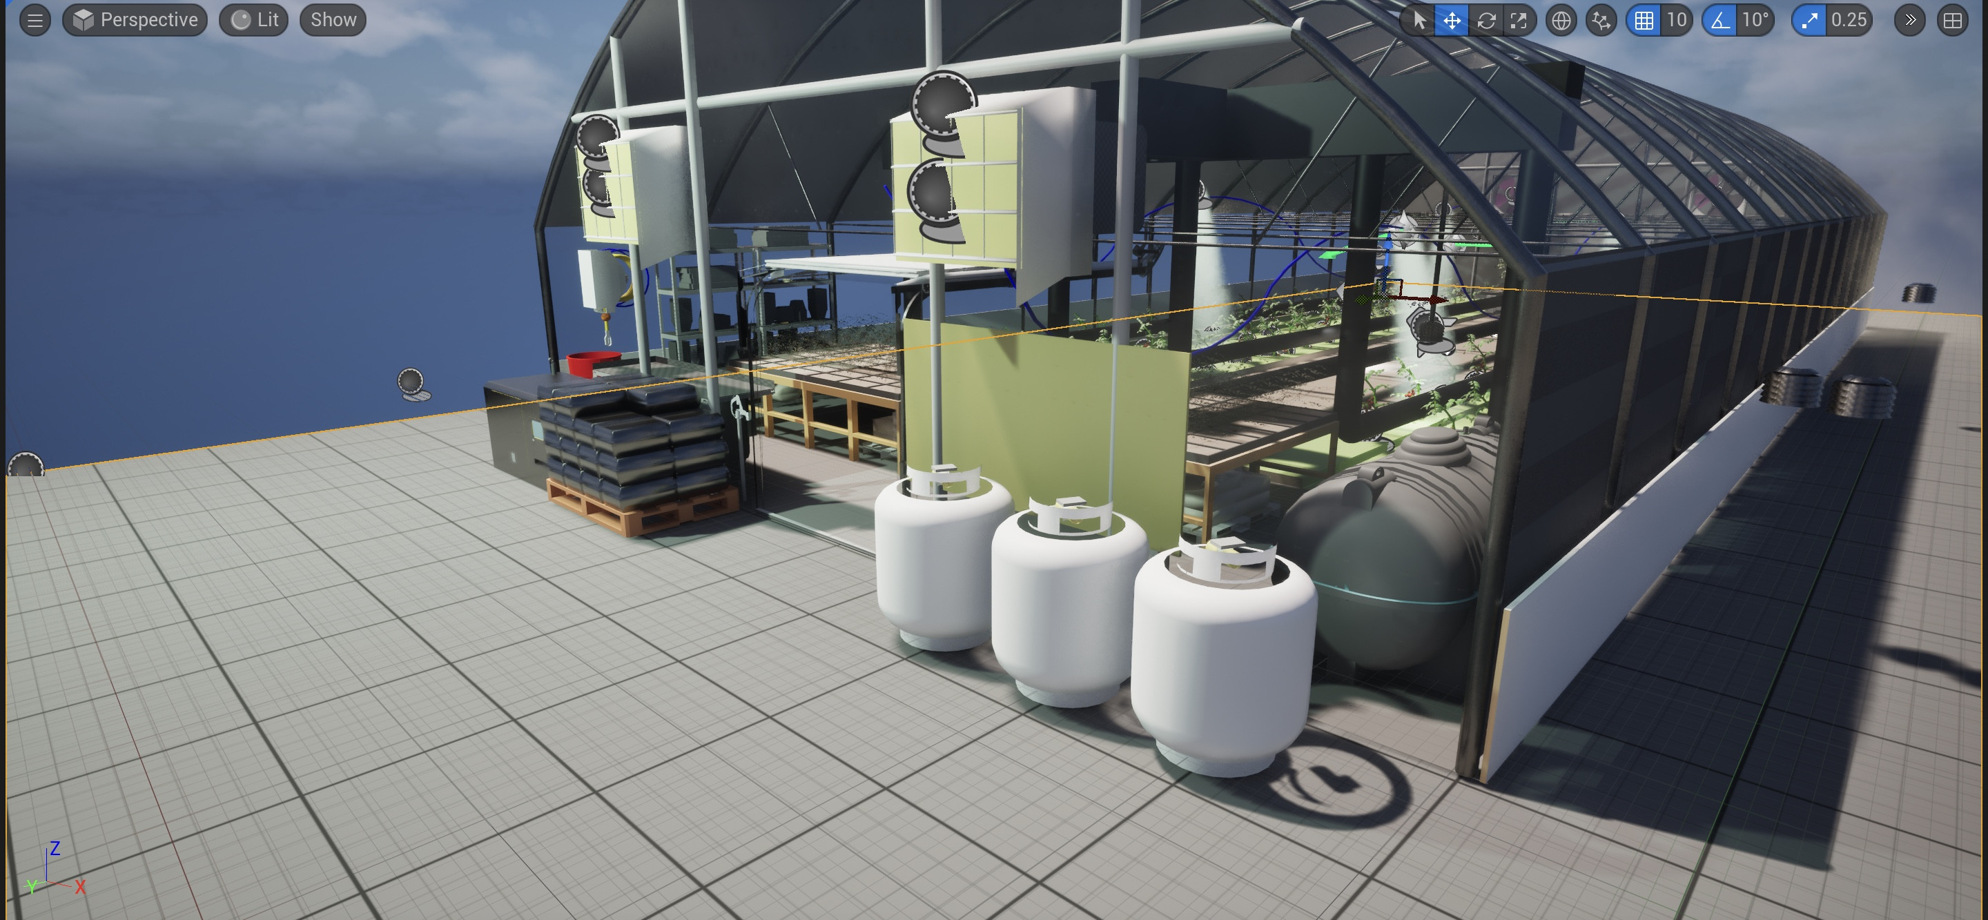
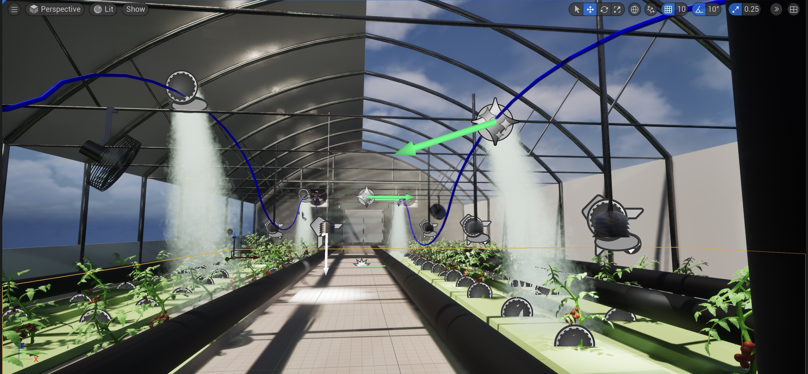

Components – Gas Cylinders, Vents, Curtains, Water irrigation system and infrastructure

Slide 7
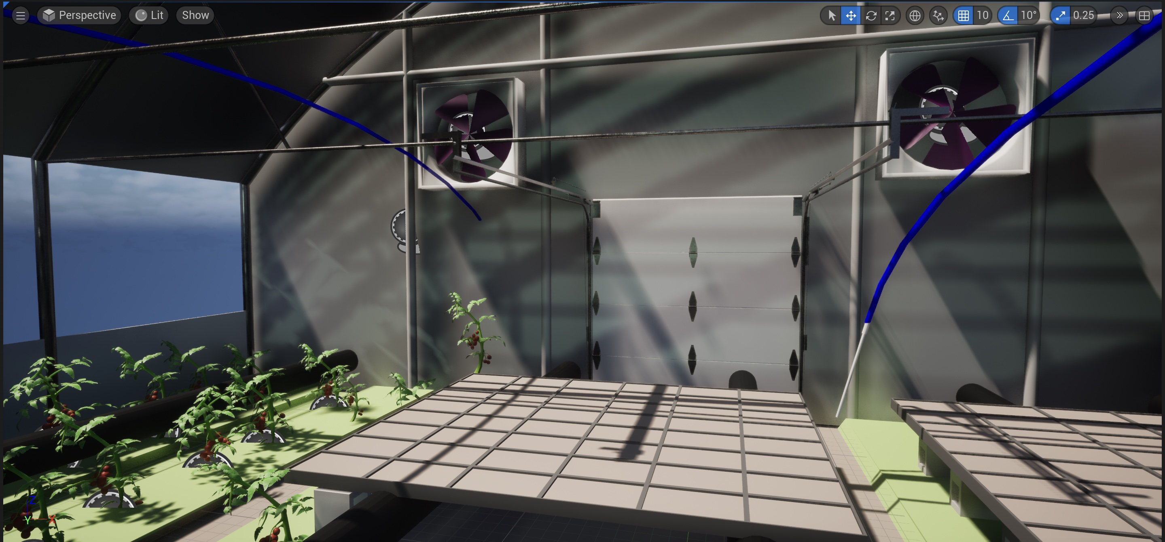
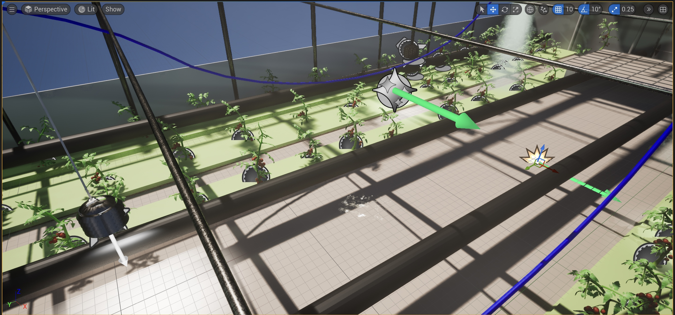
Components – Tomatoes and fans

Slide 8
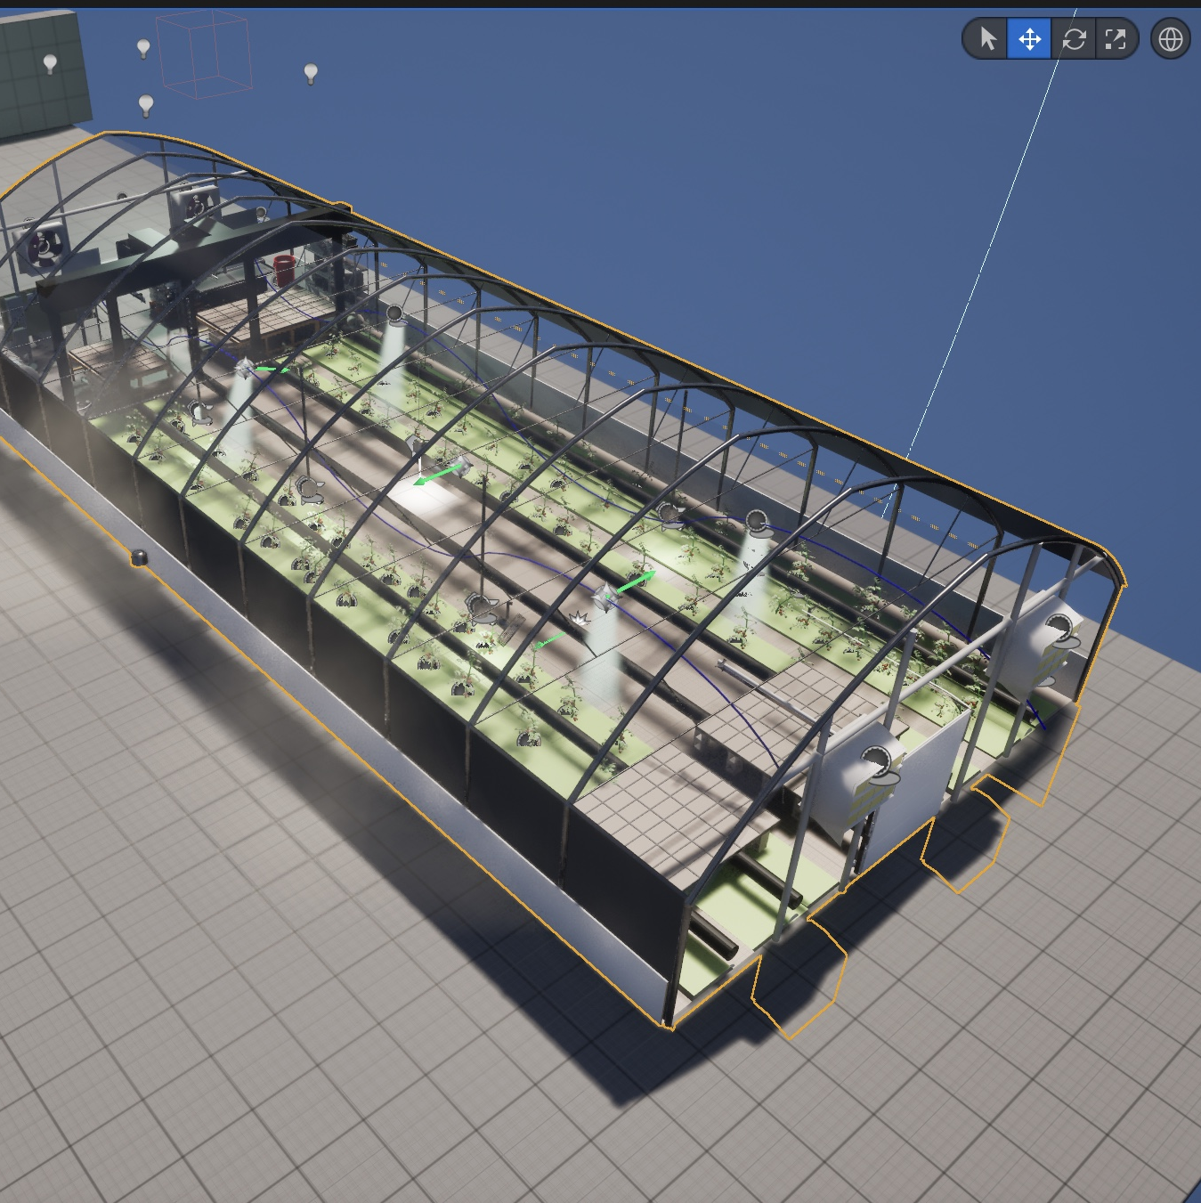
Sketchup for 3D Modeling
3D Modeling with Sketchup
Designed greenhouse and components
Applied realistic materials and textures
Focused on low-poly, high-detail models
Challenges: transparency, curved glass, lighting
Notes:
We used Sketchup to model every single component of the greenhouse from scratch.
The first step was building the greenhouse structure — including the steel framing, the glass panels, and doors. We used loop cuts, extrusion, and mirror modifiers to maintain symmetry and realism.
Next, we moved on to modeling each interior component: the gas tanks, fans, pipes, vents, irrigation system, and lighting units.
To make it realistic, we used high-resolution textures for metal, plastic, and glass, and normal maps to reduce load without losing detail.
Everything was scaled accurately and exported as FBX files for importing into Unreal.

Slide 9

Animation in Unreal Engine
Animation & Interactivity in Unreal Engine
Imported Sketchup models into Unreal
Used Blueprints for logic and behavior
Simulated environmental reactions:
Vents & curtains open/close
Fans and lamps respond to conditions
Added cinematic views with camera animation
Notes:
Once all the models were ready, we imported them into Unreal Engine and organized them into a single level.
To animate the greenhouse, we used Blueprints — Unreal's visual scripting system.
For example, when the simulated temperature rises, a blueprint triggers the vents to open automatically. When it gets too dark, another blueprint turns on the lamps.
We also built custom event triggers for things like: • Curtains opening and closing based on external light values • Fan rotations that begin when CO₂ or humidity thresholds are crossed
To make the presentation visually appealing, we used CineCameraActors and created cinematic flythroughs using the Sequencer.”

Slide 10

Blueprints for Logic and Automation
Visual scripting system used in Unreal Engine
Controls animations based on sensor values
Connects user input, environment variables, and component behavior
Examples of Blueprint triggers:
Vents open when temperature > 26°C
Lamps turn on when light drops below threshold
Curtains open based on sunlight intensity
Notes:
Slide 6 - “Before we jump to the HUD, it’s important to talk about how we made all this interaction possible — and that’s through Blueprints.
Unreal Engine’s Blueprints are a visual scripting system that let us connect logic without needing traditional code.
We created blueprints that monitor environmental conditions and trigger actions — for example:
When the air temperature crosses 26 degrees, a blueprint automatically opens the greenhouse vents.
If CO₂ drops below 600 ppm, the CO₂ tanks are triggered to release gas.
When light levels fall, the system turns on the lamps.
These blueprints act like an automation brain — they constantly monitor conditions and make adjustments in real-time.
This slide shows an example of our vent control blueprint — it checks temperature input and plays an open or close animation based on that value.

Slide 11
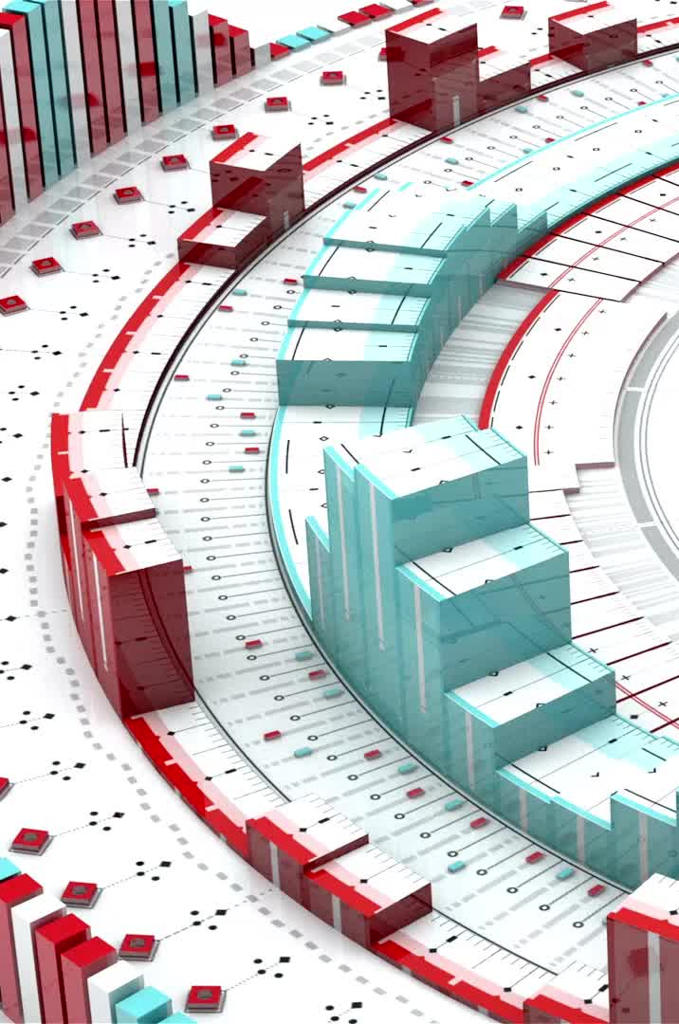
Interactive HUD and Sensors
Title: Real-Time HUD and Virtual Sensors
HUD displays:
Air temperature
Humidity
CO₂ levels
Virtual sensors trigger greenhouse changes
Dynamic environment based on simulated data
Notes:
We wanted to show users what’s going on inside the greenhouse — so we created a Heads-Up Displayusing Unreal’s UMG system.
This HUD shows: • Real-time air temperature • Humidity percentage • And CO₂ concentration levels
We wrote blueprints to simulate virtual sensors that constantly update these values.
As the values change, the greenhouse reacts — like real-life automation systems. For instance, when CO₂ levels drop below a threshold, the system automatically activates the CO₂ tank blueprint to enrich the air.”

Slide 12
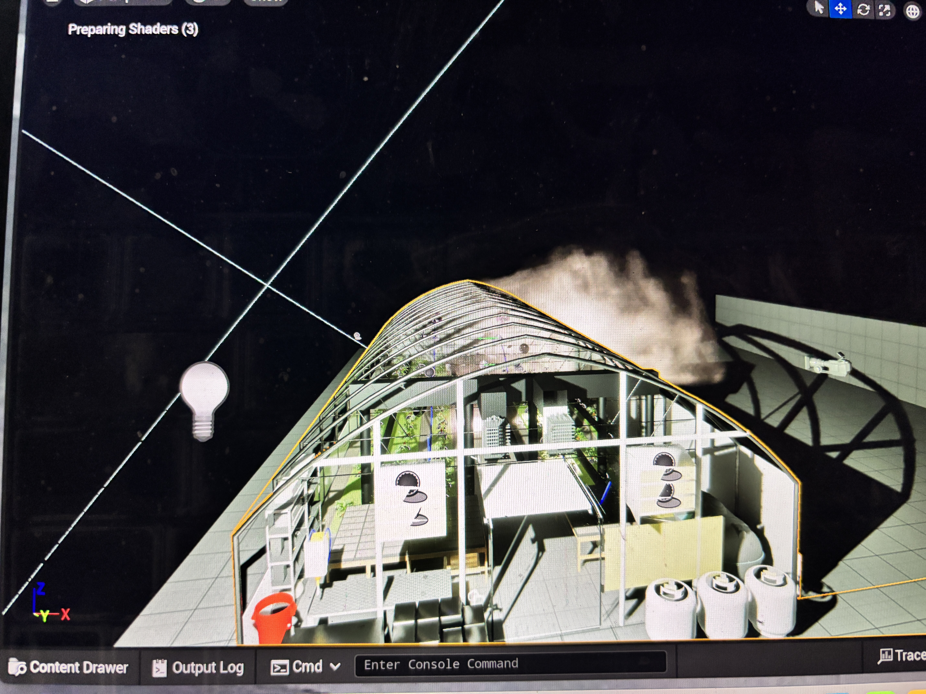
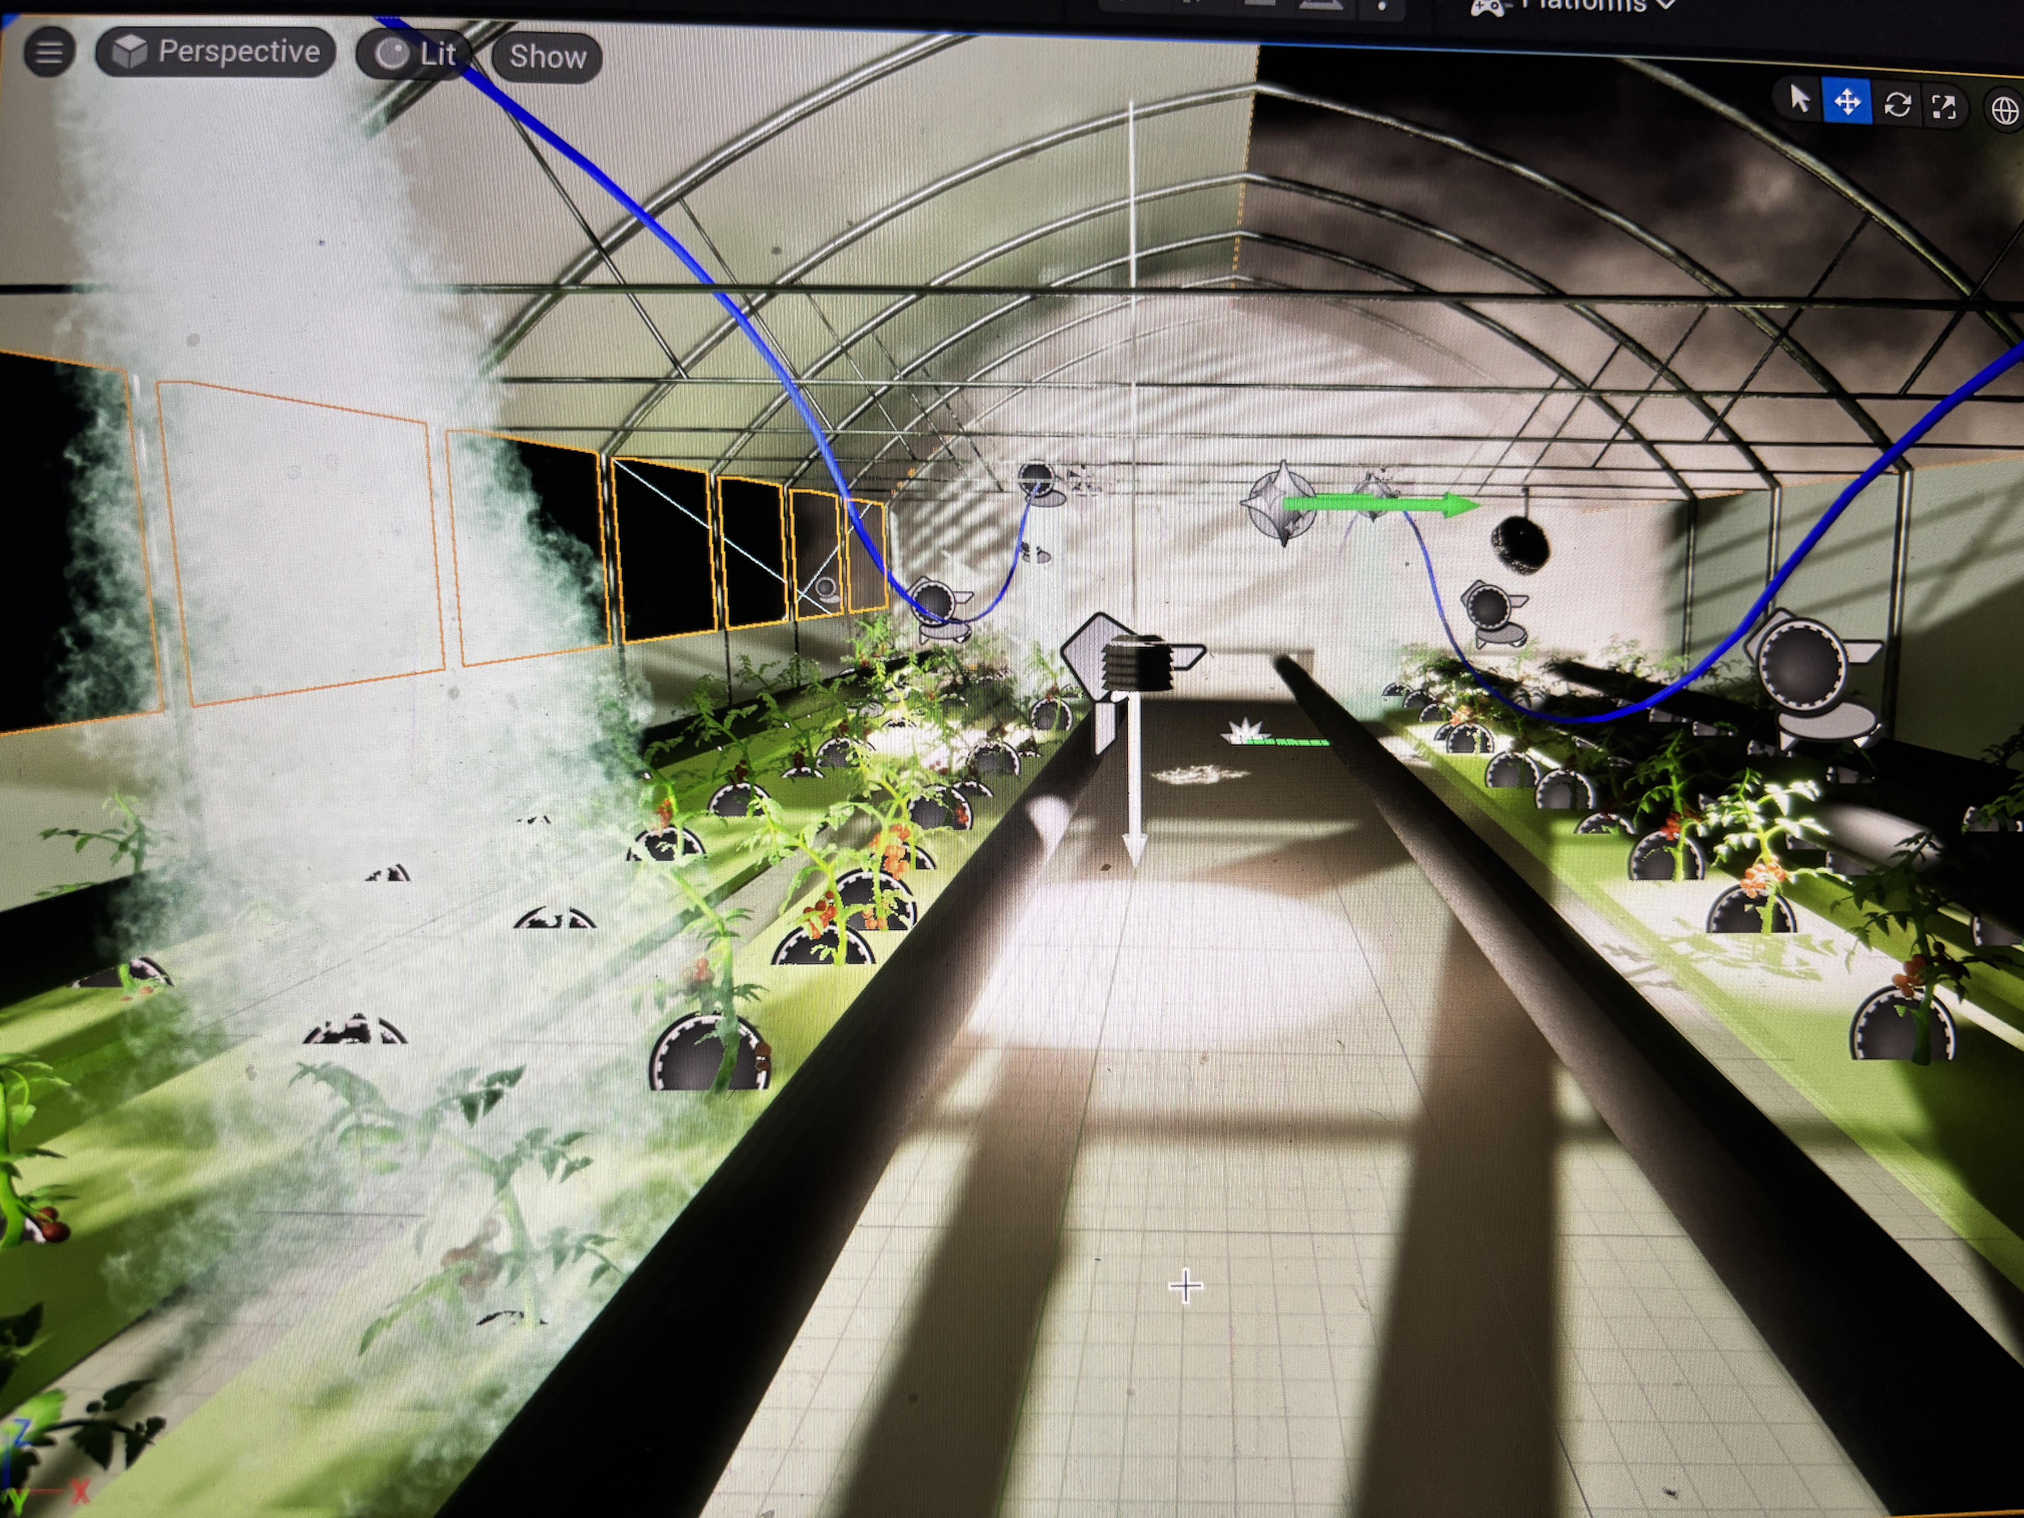
Night-time at greenhouse
Notes:
Night time looks of the greenhouse

Slide 13

Tomato Growth Simulation
Title: Simulating Tomato Plant Growth
Growth depends on:
Light intensity
Temperature
CO₂ concentration
Optimal ranges support healthy growth
Poor conditions slow or stop growth
Users can test different scenarios
Notes:
To complete the simulation, we developed a growth model for tomato plants.
We studied optimal growth ranges for tomatoes and programmed them into the system. These include: • Temperature between 22–26°C • Relative humidity around 60–70% • CO₂ concentration over 600 ppm
If any of these conditions drop below or exceed their range, the system simulates slowed or stunted plant growth.
Users can change conditions manually and see how the tomato plant model reacts, which teaches cause-effect relationships clearly.”

Slide 14

Future Improvements
Title: Next Steps & Enhancements
Add more plant types to simulation
Integrate live IoT sensor data
Use AI/ML for automated climate prediction
Improve realism and UX in the simulation
Notes:
We’re already thinking about what comes next: • One plan is to simulate different plant species with unique climate needs. • We’d also like to connect the simulation with real IoT sensors — so the simulation reflects live climate data. • Finally, integrating AI will allow the system to learn and optimize conditions for better growth without user input.
These upgrades would make the greenhouse not just interactive — but truly intelligent.

